Slide 1
A SELF LEARNING BOT
PIP2001 Capstone Project
Review-1
Batch Number: 19
Roll Number | Student Name
20211CST0015 | T MOUNIKA
20211CST0022 | K YUVA SAHITHYA PREETHI
20211CST0090 | NISBA KOUSAR
20211CST0078 | V R SHUSHMA REDDY
Under the Supervision of,
Dr. Saira Banu Atham
School of Computer Science and Engineering
Presidency University
Name of the Program: COMPUTER SCIENCE AND TECHNOLOGY (AI-ML)
Name of the HoD: Dr. Saira Banu Atham
Name of the Program Project Coordinator: DR . MANJULA H M
Name of the School Project Coordinators: Dr. Sampath A K / Dr. Abdul Khadar A / Mr. Md Ziaur Rahman

Slide 2
Introduction
A Self learning Bot is basically used to get relevant answers for the user queries ,here in a self learning bot we use python , NLP, ML.
As we know python is a programming language , we use python as our main language to build a self learning bot.
We use NLP and ML along with python , NLP is used for understanding and to process the human language , sentiment analysis and many others to maintain good communication. And we use ML to make the bot learn from data and improve its responses.

Slide 3
Literature Review
The first time a Bot was created was in , 1966 by an MIT professor names JOSEPH WEIZENBAUM and named it as ELIZA. It was casted in the role of psychotherapist.
After Eliza , PARRY was one of the 1st chatbot to gain significant popularity. Which was developed by KENNETH COLBY in the early 1970s.
ALICE(Artificial Linguistic Internet Computer Entity) was the next chatbot in the early 2000s , developed by Richard Wallace. It was used to engage in human like conversations on a wide range of topics.
SmarterChild is another type of chatbot that gained its popularity around the same time , it was developed by Verbot it had the capability to complete tasks such as searching web etc.

Slide 4
Existing method Drawback
Eliza – Limited understanding .
This drawback overcame by the Advanced NLP techniques, LLMs and DL.
Parry – Repetitive responses.
We use a new strategy with Improved pattern matching algorithms and contextual understanding.
ALICE – Lack of context
To overcome this we use memory mechanism and dialogue history tracking.
SmarterChild – Limited knowledge base
Access to vast amount of real-time information and continuos learning was used to overcome this.
Chatgpt – Hallucinations
Fact checking mechanism , RL from human feedback and improved model architecture.

Slide 5
Bots in 1960s
Bots in 2000s
Has limited understanding of language.
They were restricted to limited information.
And they were limited to narrow application.
These bots can engage in more natural and meaningful conversations.
Can learn and adapt to new information.
They have much wider range of uses.

Slide 6
Proposed Method
A proposed method could combine advanced AI techniques with user-centric design to overcome existing limitations.
Multi-Layered AI Approach
Hybrid Model: Combine rule-based and AI-driven methods to balance simplicity and flexibility. Use rules for basic queries and AI for more complex interactions.
NLP and Machine Learning: Implement Natural Language Processing (NLP) models to understand the intent behind user messages. Train these models with large datasets to recognize different ways people phrase their questions

Slide 7
Objectives
Enhance Answer Relevancy.
Incorporate Transliteration Capabilities.

Slide 8
Methodology/Modules
Natural Language Processing (NLP) Module:
Enables the chatbot to understand, interpret, and respond to user input in natural language.
Conversation Management Module:
Manages the flow of the conversation, ensuring the chatbot can handle multi-turn dialogues.
Knowledge Base Integration Module:
Gives the chatbot access to a database of information to answer questions accurately.
Sentiment Analysis Module:
Detects the emotional tone of the user’s input to adjust the chatbot's response.

Slide 9
Hardware/software components
NLP (Natural Language Processing) is a vital component of a self-learning bot that allows it to understand and generate human language. It employs various techniques for text analysis, such as tokenization and entity recognition, enabling the bot to interpret user inputs accurately. By utilizing NLP, the bot can engage users in meaningful conversations, offering relevant and personalized responses.
Moreover, NLP techniques continuously adapt based on user interactions, enhancing the bot's ability to respond appropriately over time, which improves the overall user.
Python is the primary programming language used for developing the self-learning bot, chosen for its simplicity and extensive libraries. Key libraries include NLTK, which facilitates essential text processing tasks, and Multinomial Naive Bayes, a machine learning algorithm that efficiently classifies user inputs based on training data. The TF-IDF (Term Frequency-Inverse Document Frequency) technique is utilized to evaluate the importance of words in user queries, improving the bot's understanding of context and relevance. Additionally, Streamlit provides an interactive web interface for users to engage with the bot, making it easy to visualize interactions and results. The integration of a Pipeline streamlines the workflow, allowing for seamless processing of data through various stages, from preprocessing to classification, ensuring the bot operates efficiently and effectively.

Slide 10
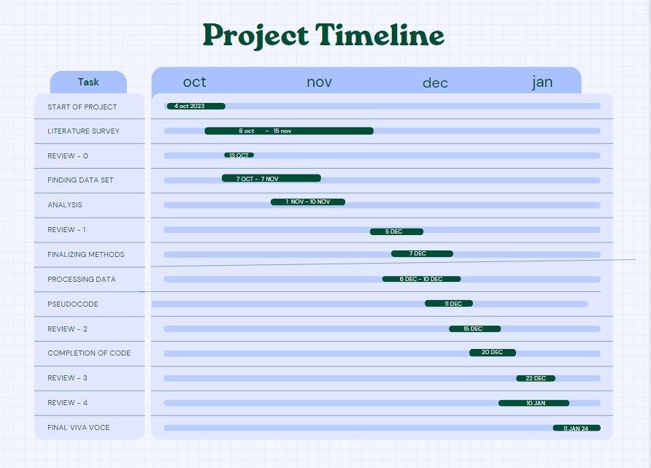
Timeline of Project

Slide 11
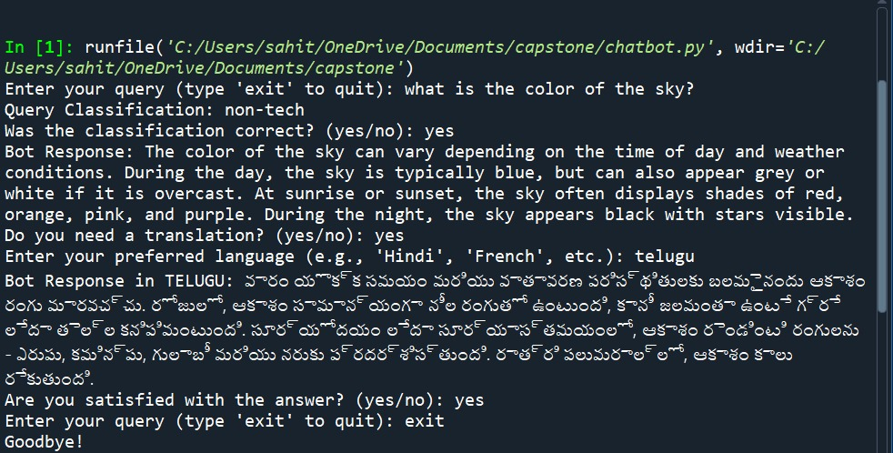
Expected Outcomes

Slide 12
Conclusion
The project of developing a self-learning bot using NLP and Python represents a significant advancement in artificial intelligence and user interaction. By leveraging Natural Language Processing, the bot can understand and respond to user queries in a human-like manner, creating engaging and personalized experiences.
The flexibility and power of Python facilitate the integration of various machine learning techniques, allowing the bot to continuously learn and adapt based on user interactions. This ongoing learning process improves response accuracy and enhances the bot’s ability to meet evolving user needs.
Utilizing Streamlit enables the development of an interactive web interface, making it easy for users to engage with the bot in real-time. As a result, the self-learning bot stands as a valuable tool across various applications, from customer support to personal assistants.
Ultimately, this project demonstrates the potential for improved efficiency and satisfaction in user interactions. As technology continues to advance, the self-learning bot will play an increasingly critical role in shaping the future of communication between humans and machines.

Slide 13
Github Link
The Github link provided should have public access permission.
Github Link
https://github.com/vrshushma/capstone

Slide 14
References
[1] Thosani, Parth, Manas Sinkar, Jaydeep Vaghasiya, and Radha Shankarmani. "A self learning chat-bot from user interactions and preferences." In 2020 4th International Conference on Intelligent Computing and Control Systems (ICICCS), pp. 224-229. IEEE, 2020.
[2] Kaiss, Wijdane, Khalifa Mansouri, and Franck Poirier. "Chatbot design to help learners self-regulte their learning in online learning environments." In 2023 IEEE International Conference on Advanced Learning Technologies (ICALT), pp. 236-238. IEEE, 2023.
[3] Vinyals, Oriol, and Quoc Le. "A neural conversational model." arXiv preprint arXiv:1506.05869 (2015).

Slide 15
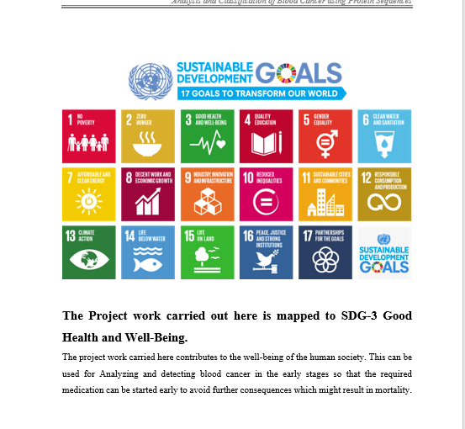
Project work mapping with SDG

Slide 16
Thank You

